Slide 1


Revolutionizing Methadone Delivery (IORPMS)
LVCT Health
Dr. Lyani Sitti

Slide 2
Background
Stawisha Pwani:
HIV/AIDS program serving 71,000+ PLHIV across Kilifi, Kwale, Mombasa, Taita Taveta.
MAT Impact: Cumulative ever on MAT are 1785, 1260 and 3227 in Kilifi, Kwale and Mombasa respectively with a retention of 716, 652, 1180 on MAT.
Operational clinics: Kombani, Kisauni, Malindi, Kilifi satelites, Miritini, Shimo La Tewa, Watamu.
PLHIV: 92 (Kilifi), 51 (Kwale), 145 (Mombasa) active clients;

Slide 3
Coast MAT Implementation journey
MAT Inception and Scale up
Models of MAT Dispensing
Initiated in Coast in December 2015 in Malindi, 2016 in Mombasa and Kwale 2017 and Lamu
8 facilities to date in 4 Coastal counties.
1 prison dispensing sites
2 Clinics at different operationalization levels
Integrated Daily Observed Treatment Sites
Prison Dispensing sites
Decentralized Fixed Dispensing Site(Satellite Clinics)
Exceptional take home dosing (hospitalization and Buprenorphine)
Community Partners/CSOs and LIPS Supporting MAT Clinics
Mombasa- Reach Out Trust and MEWA, Kilifi-MEWA and TOP, Kwale-RCT and Teens Watch

Slide 4
MAT Performance
County | KP Size estimates | No. active (%) | Donor Target | Achievement (%)
Kilifi | 4,308 | 732 (17%) | 2,154 | 732 (34%)
Kwale | 1,736 | 655 (38%) | 868 | 655 (75%)
Mombasa | 2,591 | 1187 (46%) | 1,296 | 1187 (92%)
Total | 8,635 | 2574 (30%) | 4,318 | 2574 (60%)
Despite the high estimated population of People Who Inject Drugs (PWID) in the region, MAT coverage remains suboptimal, largely due to limited dispensing infrastructure.
Currently, services are provided through five MAT clinics and three satellite dispensing sites, which are insufficient to meet the existing demand.

Slide 5
Problem Statement
The current dispensing system is costly, non-scalable, and unsustainable.
Initial setup cost is KES 3.5 M + KES 250K–800K maintenance cost/year thus unaffordable after donor transition.
Inadequate and delayed technical support and response
Manual inter-departmental referrals
No MoH reporting or client progress monitoring
The other dispensing options are
Error-prone manual Excel/paper-based, that risks duplicate dosing and TCA violations.
Dispensing delays cause client unrest.

Slide 6
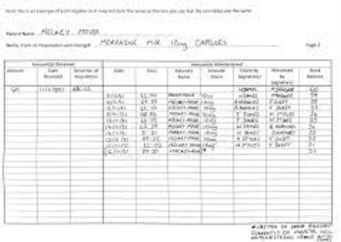
Objectives
Improve efficiency and accountability in controlled drugs delivery.
Eliminate manual records and reduce reliance on costly software.
Enhance patient verification with fingerprint scanners and real-time analytics.
Integrated patient management system

Slide 7
Our Solution: IORPMS – Local Innovation
Free, offline, open-source semi-automated system with 8 scalable modules.
Digitized: Fingerprint verification, role-based access control
Prison multi-dispensing
Enhanced dispensing security features
MoH report generation.
Interoperable through APIs.
Integrated patient appointment management system
HIV, psychosocial, missed doses, toxicology tests etc

Slide 8



How does the system work?
Search patient by:
Name, Unique Identifier (MAT Id), fingerprint
Dispense by:
Syringe or Dispensette –S titration machine
Reports generated:
consumption, patient summary, appointments,
deleted prescriptions, returns, expiries etc
5
seconds
15
seconds
5 - 90
seconds

Slide 9




IORPMS - Benefits
Digitized Patient Management:
One-time registration, role-based access for clinicians, pharmacists, nurses, etc.
Compliance Safeguards
Automated dose tracking, blocks duplicate dosing, and enforces appointment management.
Interoperability:
Open-source with options to link with other existing softwares
Scalability
8 modules included
(Psychocosocial, clinician, laboratory, etc)
A locally developed, free, offline, and open-access semi-automated methadone dispensing system piloted at Shimo La Tewa and Faza clinics.

Slide 10
IORPMS - Benefits
Costs comparison
 |  | Current System | IORPMS
Item Description | Qty | Amount(KES) | Amount(KES)
Desktop/Software/ Pump | 1 | 3,500,000.00 | 100,000.00
Annual renewal | 1 | 202,000.00 | -
Pump | 1 | - | 180,000.00
Camera | 1 | 13,000.00 | 13,000.00
Fingerprint Reader | 1 | 20,000.00 | 20,000.00
Networking | 1 | - | -
Training costs | 1 | - | 100,000.00
Migration costs for existing clinic | 1 | 200,000.00 | 100,000.00
 |  | 3,935,000.00 | 513,000.00
Cost-efficiency
One-time registration, role-based access for clinicians, pharmacists, and nurses.

Slide 11
Market Opportunity
Existing software
IORPMS
Malindi
Watamu
Kisauni
Teens
Kombani
Shimo
Miritini
King’orani
Faza
Kilifi prisons
Kilkifi stateline
20+ expected MAT clinics in Kenya; KES 70M+ startup software saved.
14 + existing clinics;
18,000+ clients need efficient, compliant dosing.
National rollout potential via NASCOP/MoH alignment.
5x growth projection in 3 years.
IORPMS
Scaleup

Slide 12

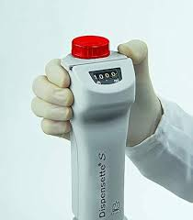


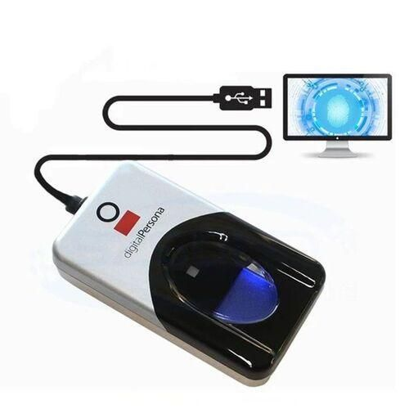
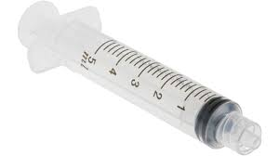
Technical Architecture
Offline-first: Local database ensures uptime in low-connectivity areas.
Server (XAMPP/WAMP)
MySQL ver 5.2.1 and above
PHP ver 8 and above
Windows 10 and above
RAM at least 4GB
Storage at least 512GB HDD
Fingerprint scanners for secure patient verification.
Modular design: 8 modules (e.g., dispensing, clinical, reporting, appointment etc).
Future-proof: API-development for MoH digital health integration.

Slide 13
Results
87% cost reduction (KES 513K vs. KES 3.9M);
No annual licensing fees.
No periodic server maintenance costs
Zero manual errors in pilots
90% faster dispensing.
MoH reports compliant
Real-time client analytics.
Scalability recommended.

Slide 14
New Facility Systems Implementation Process Plan
A structured roadmap for effective deployment, training, and system rollout.

Slide 15
1. Project Initiation & Planning
Identify stakeholders and define objectives
Form implementation team and develop project charter
Prepare communication and risk management plan
Deliverables: Project charter, work plan, risk matrix
Notes:
Suggested visual: Project timeline visual or stakeholder map

Slide 16
2. Requirements Gathering & System Assessment
Review existing work-flows and systems
Collect user requirements and assess infrastructure
Identify interoperability and data protection needs
Deliverables: Requirements document, gap analysis report
Notes:
Suggested visual: Flowchart showing data flow or requirement mapping

Slide 17
3. System Setup & Installation
Procure missing hardware and install necessary software
Backup data from existing system if any
Configure roles, permissions, and modules
Deliverables: Installation checklist, test report, feedback report
Notes:
Suggested visual: Server setup or configuration dashboard

Slide 18
4. User Training & Capacity Building
Conduct role-based training
Assess user proficiency and collect feedback
Deliverables: Trained users, evaluation report
Notes:
Suggested visual: Training session or classroom image

Slide 19
5. Data Migration & Cleaning
Extract legacy data and clean inconsistencies
Map and migrate validated datasets
Deliverables: Clean data set, migration validation report
Notes:
Suggested visual: Data transformation or database migration diagram

Slide 20
6. On-site Dry Run / Pilot Phase
Run system parallel to existing workflows
Collect user feedback and fix any bugs
Deliverables: Pilot test report
Notes:
Suggested visual: System test or pilot feedback graphic

Slide 21
7. Post-Implementation Monitoring & Support
Track performance, data accuracy, and user adoption
Provide technical and functional support
Deliverables: Monthly reports and performance report
Notes:
Suggested visual: Helpdesk or dashboard analytics image

Slide 22
Summary Timeline
Phase 1: Assessment & Installation (1 day)
Phase 2: Data migration (5 days) – depending on database
Phase 3: Training (2 days)
Phase 4: Dry-run (1 day)
Phase 5: Monitoring (routine)
Phase 6: Reporting (monthly)
Total Duration: 9 days
Notes:
Suggested visual: Gantt chart or timeline visualization

Slide 23

Proposed non-proprietary name for National rollout
Suggests a smooth, efficient, and streamlined process for prescriptions.
RxFlow
A direct and clear name, combining "opioid" with "Rx" (the medical abbreviation for prescription).
OpioidRx
An acronym for "Medication-Assisted Treatment," a widely recognized term in the field, with "Relief" providing a positive connotation.
ReliefM.A.T.

Slide 24
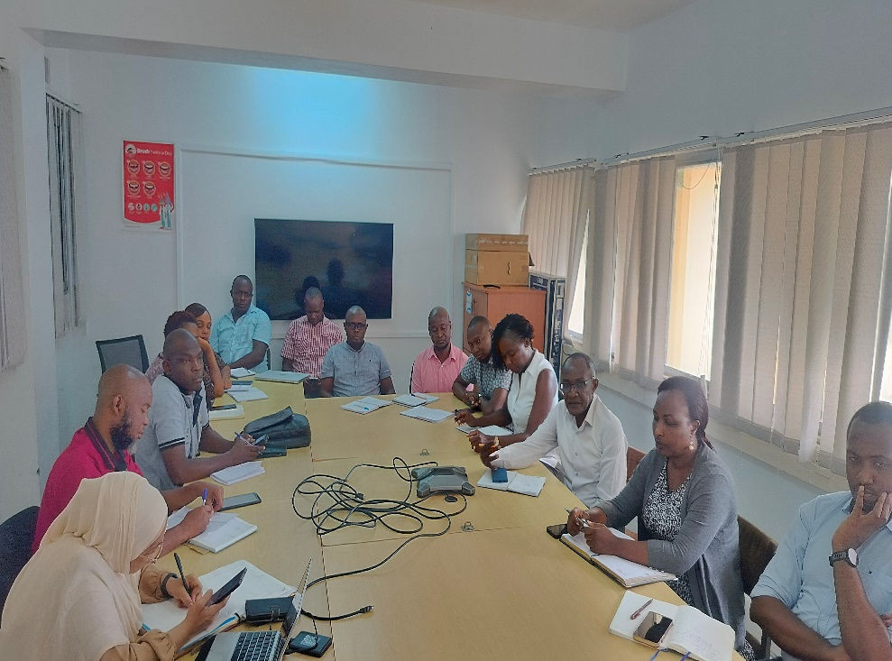
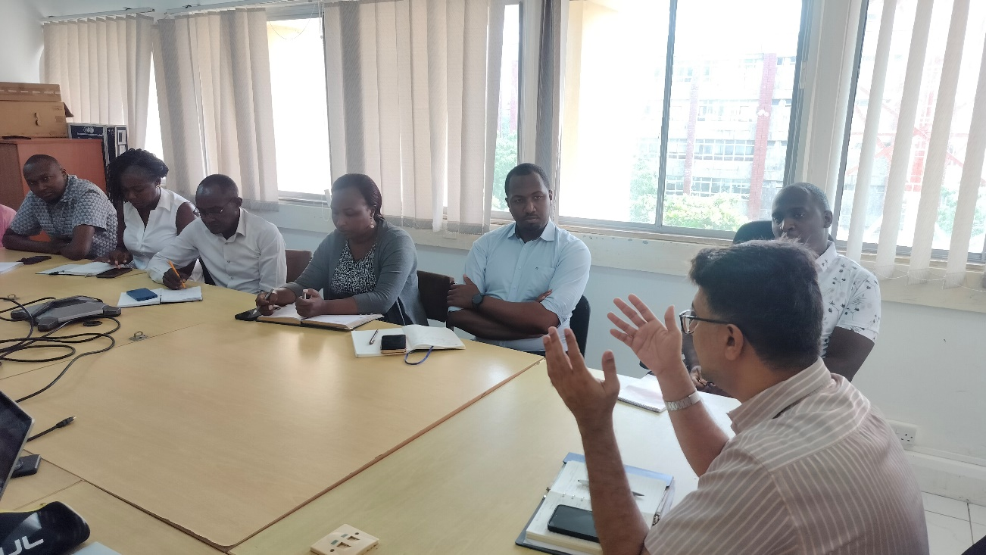
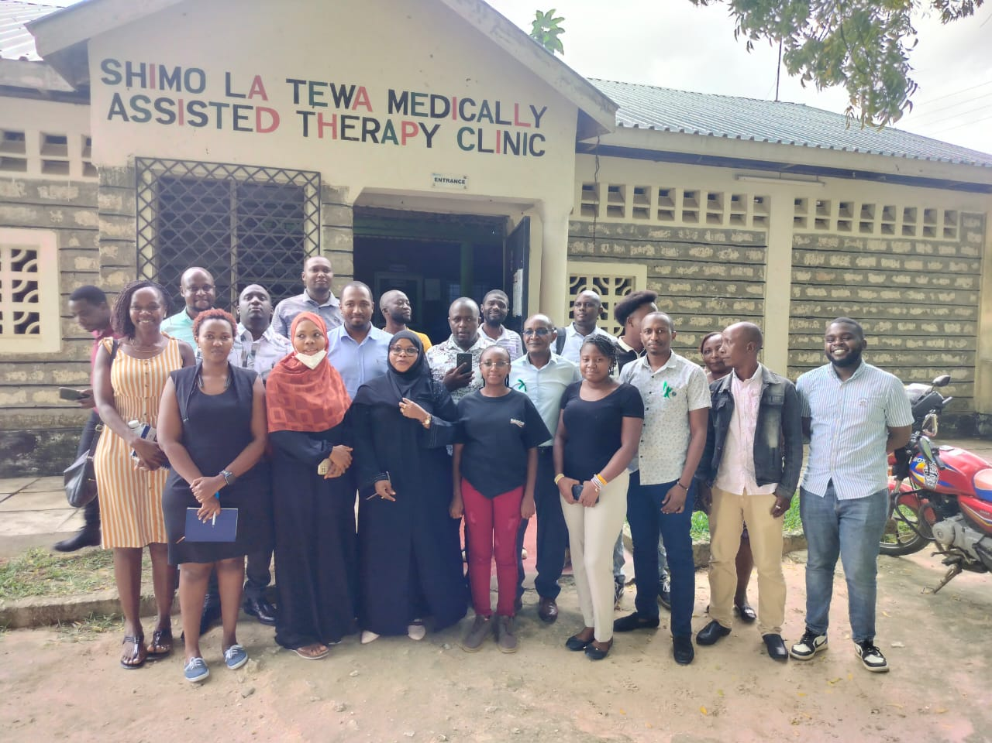
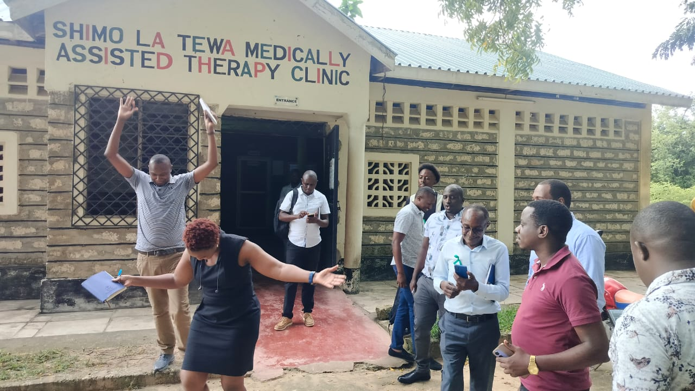
Kiambu County CHMT and LVCT Dhibiti project; exchange visit 2025 to Mombasa MAT clinics

Slide 25
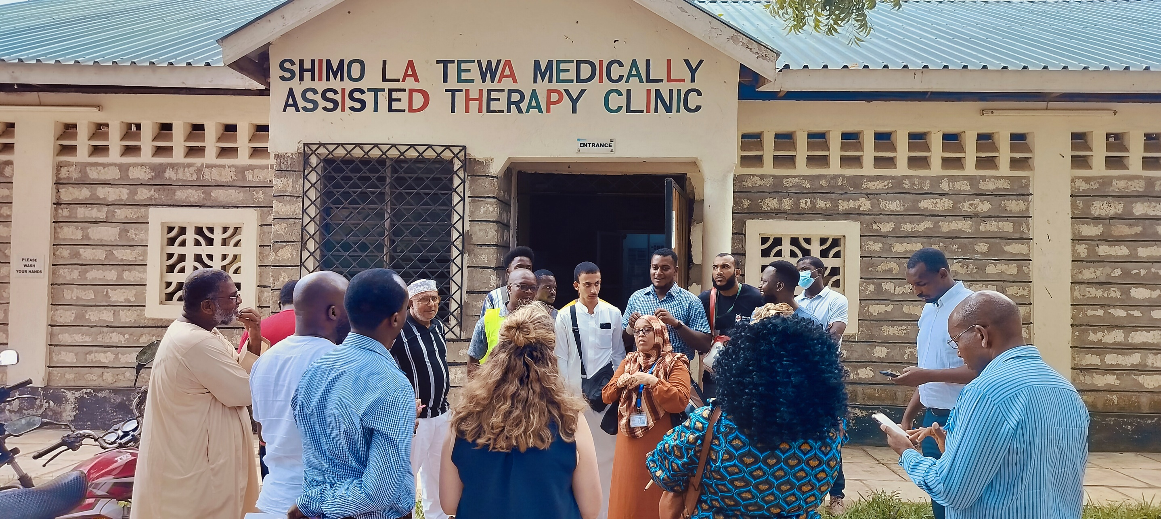
Cross-learning visit by USAID IP foreign countries Jan 2024

Slide 26
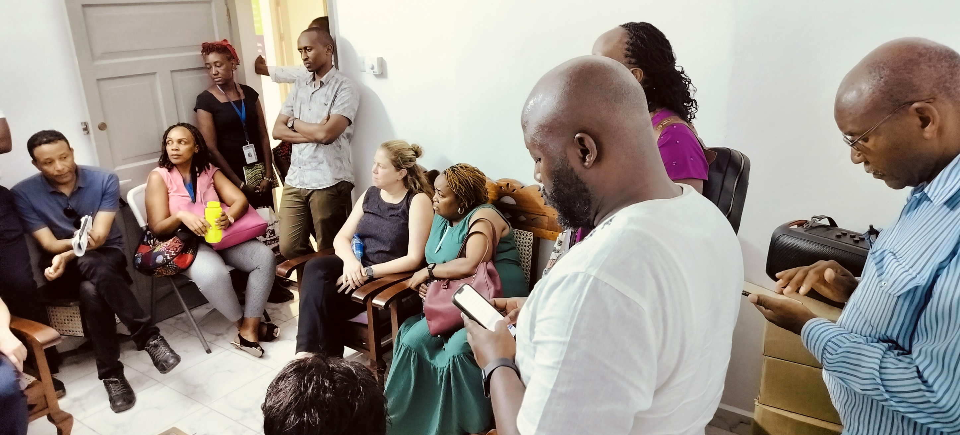
Cross-learning visit by USAID IP African countries Jan 2024

Slide 27
Business Model: Sustainable Impact
Core system free
Revenue from custom modules/training e.g. for SHA claims.
KES 50K/clinic for add-ons (e.g., advanced analytics).
Partnerships: MoH, philanthropists for national rollout.
Social enterprise: Impact first, profits reinvested.

Slide 28
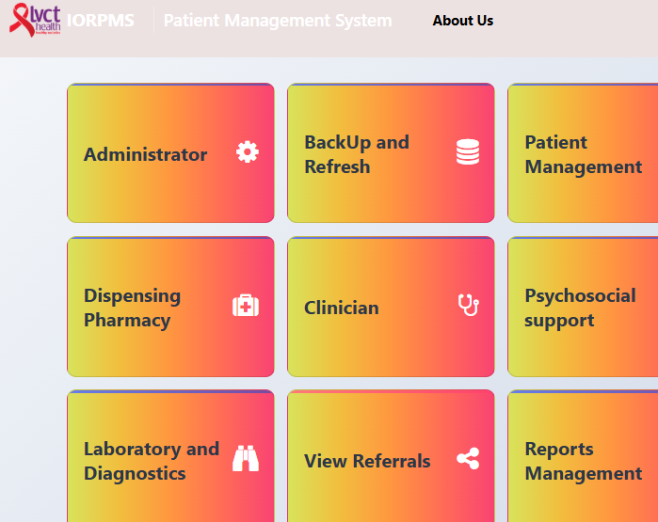
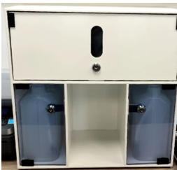
The Ask: Join the Revolution
Goal: Serve 15,000+ clients by 2027.
Partner with us: MoH, NGOs, investors.
What is required
Local manufactured pumps + Engineers + developers + funds

Slide 29
Testimonials: Voices from the Field
“IORPMS cut errors to zero—game-changer!” – Pharmacist, Shimo La Tewa.-
“Clients now get doses in seconds, not minutes.” – Nurse, Faza.- “Scalable and compliant.” – NASCOP Audit Report.
Video: https://drive.google.com/file/d/1K8I__3IMq0xPb5cmIF9W7XLwyoDX5lvu/view?usp=sharing

Slide 30






Our Team: Built for Success

Slide 31


THANK YOU
Contact us
www.lvcthealth.org www.lvctgroup.org www.one2onekenya.org
@LVCTKenya
@lvctKe
LVCTHealth
TheLVCT

